Slide 1
AI Case Studies for the Banking

Slide 2
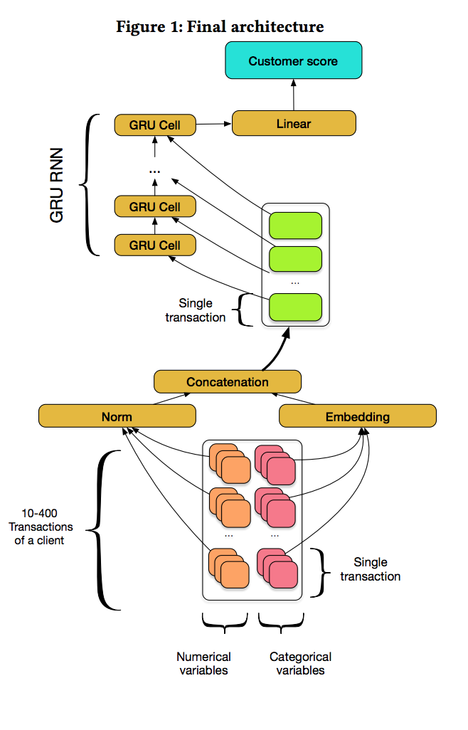
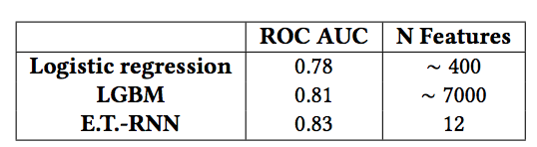
RNN: Applying Deep Learning to
Credit Loan Applications
Abstract
We used RNNs on fine grained transnational
data to compute credit scores for the loan applicants
RESULTS
https://arxiv.org/pdf/1911.02496.pdf

Slide 3
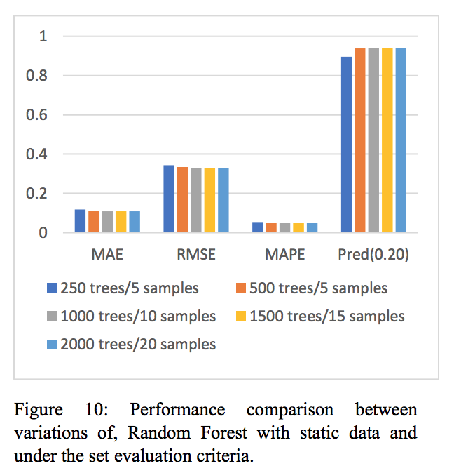
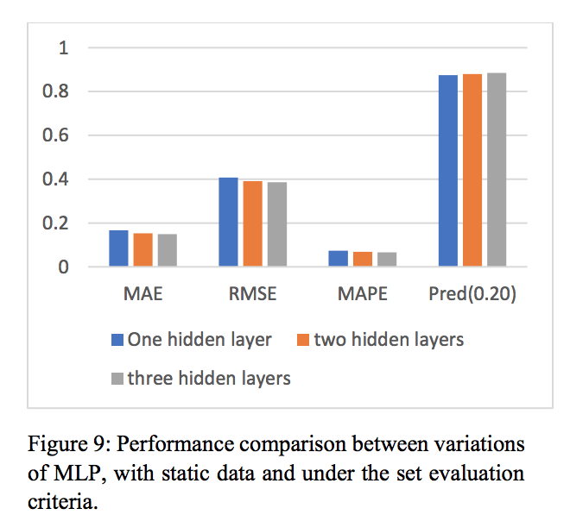
Transaction Confirmation Time Prediction in
Ethereum Blockchain Using Machine Learning
https://arxiv.org/pdf/1911.11592.pdf
The objective is to determine whether machine learning offers a more accurate predictive model than conventional statistical models

Slide 4
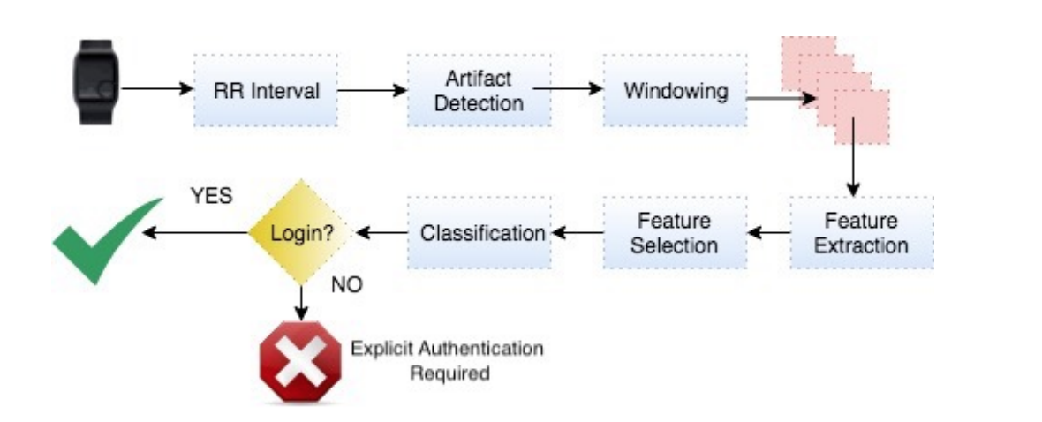
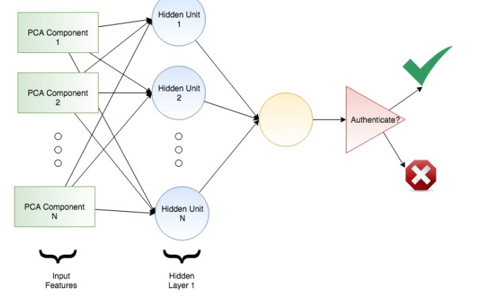
Your Smartband Smart Enough to Know Who You Are: Towards Continuous Physiological Authentication in The Wild
https://arxiv.org/pdf/1912.04760.pdf
The use of cloud services that process privacy sensitive information such as digital banking, pervasive healthcare, smart home applications require an implicit continuous authentication solution which will make these systems less vulnerable to the spoofing attacks

Slide 5
